Slide 1
General Assembly Data Science: Final Project
Casey MaGann

Slide 2
Project Problem Statement
A national survey rated our state as one of the lowest for available technology. After hearing this the Governor of our state declares, “We need to come up with impactful technologies that can be implemented in our cities and state as a whole that are subsidized by state and federal tax credits.”
A panel was held following the meeting and one proposed idea was the following: Install EV charging stations in high density parking areas.
Panel member suggestion / comment:
“Good idea but we do not know anything about EV charging stations.” “Ask the data folks in the basement and see what they can tell us.”
SMART Goals: We will analyze the 2017 EV charging station data for all U.S. states and cities. Within the next thirty days the data team will research the number of EV stations currently installed in each state and city by population. These findings will be used to predict the number and type of EV stations to install in our city and individual locations.

Slide 3
Project Outline
Goal: Obtain a data set(s) containing the number and type of EV stations in place within each state, city, and population. Create a linear regression model to predict how many and what type of stations to install for a given population.
Objective: Obtain a starting point to base the number and type of EV chargers to install in our city
Risk: The availability of the required data
Assumptions: The data is available and there will be enough data to create a model from
Identify the problem
Acquire the data
Parse the data
Mine the data
Refine the data
Build a data model
Present the results

Slide 4
Exploratory Data Analysis & Modeling
Data Set: Obtained a data set containing alternative fuel data from energy.gov (dept of energy). The data set contains the number, type, and individual cities for all alternative fuel stations in the continental U.S., including EV. Research information for context such as subsidies obtained at pluginamerica.org.
Initial EDA: Created a dummy notebook from the data set to get a feel of what overfit scores would look like. Record dates are included in the data set and were to be used to create a time series but the dates are grouped on the day(s) they were entered which is approximately five unique values. With a lack of usable features the initial model returned very poor scores. A second data set was obtained from cencus.gov that contained the populations for all U.S. cities. I used a concatenate function on both data sets to create an index to merge on and saved them locally as csv files. Once saved, I merged the two data sets, reset the indexes, prepped features, created new features, and plotted to determine relationships.
Model 1: Grouped by city in order predict to the total and type for the entire city as a baseline
Model 2: Not grouped by city in order predict to the total and type for individual locations

Slide 5
Modeling Details (overview for peers)
populated all EV NaN with zeros
created an EV station total column and removed zero values eliminating the need for a dummies column
filtered the final dataframe to determine population cat
filtered data
ran simple model
ran k-folds with 5, 3, and 2 splits
ran grid search
ran ols, lasso, and ridge
Future model: Will build a logistic regression model to let it classify the populations and determine which number and type of EV station would be available

Slide 6
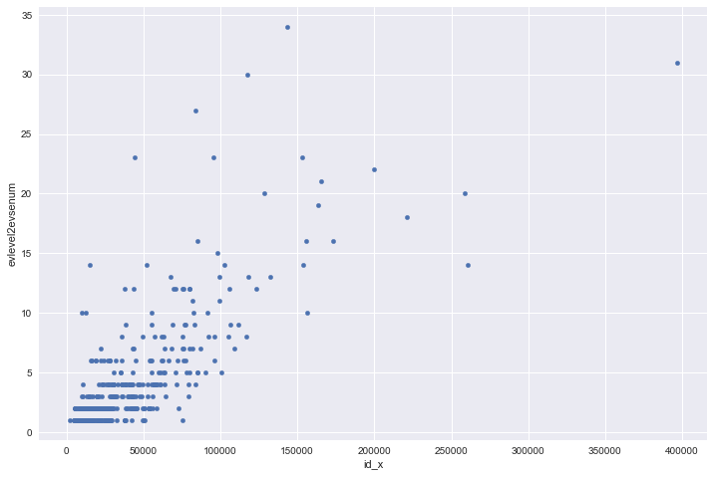
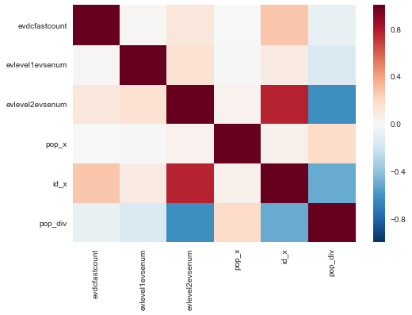
Visualizations – Model 1 Grouped by City
scatter example – 220 EV to station id correlation example – all features

Slide 7
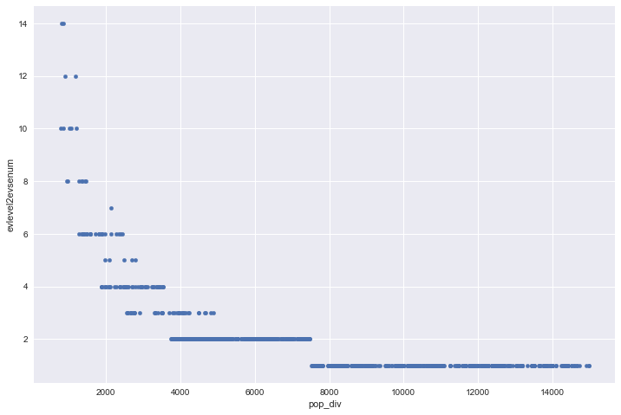
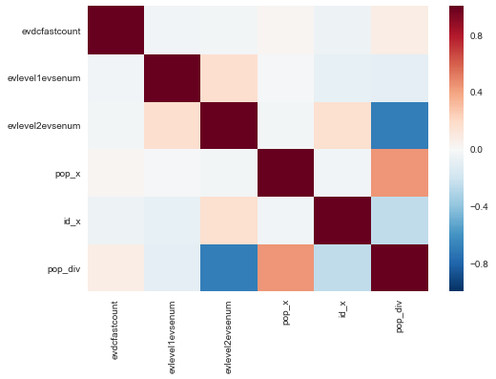
Visualizations
scatter example – 220 EV to population divided by station numbers correlation example – all features

Slide 8
Recommendations
Studied current trends on pluginamerica.org
Would recommend installing a total of eight 220 chargers in groups of two within densely populated locations. Eight individual stations will compensate for near future demand.

